Slide 1
DL ASG 2
Team 03:
S10203318 | Ben Aw Yong Keen Weng
S10205038 | Isha Kamal Jethmal
S10206050 | Yeo Hiong Kai
S10204829 | Neo Rei Siang Edward
S10203375 | Low Tze Han Dexter
Notes:
Edward - Good Morning Maam, I am edward Neo and my fellow group mates are Ben, Isha, Hiong Kai, and Dexter. We will be presenting on our assignment 2 today.

Slide 2
PART 1 (GROUP)
01
Overview
Notes:
Edward - Before diving into the models, I will first go through the overview of the group assignment.

Slide 3
Approach Of The Assignment
Load and clean data
Tokenize data and convert scores into binary class matrix
Build and train model
Test and compare with the group’s models
Use the best model to predict an input to see if its given the correct score
Universal Machine Learning Workflow will be followed
Problem Of The Assignment
Build a sentiment analysis model to predict the app’s review score based on the Google Play Store reviews.
Overview
Objective Of The Assignment
Create a deep learning model that is trained to accurately make probability predictions output that correctly assigns a review to a label
Notes:
Edward - The problem of the assignment is to build a sentiment analysis model to predict the app’s review score based on the Google Play Store reviews. The objective is to train a model to accurately make probability predictions output that correctly assigns a review to a label. The approach consists of a few steps, load and clean the data, tokenize reviews and convert scores into binary matrixes, build and train models and to test and compare these models. Finally, use the best model to predict an input to see if its assigned correctly. The universal machine learning workflow will also be followed closely.

Slide 4
PART 1 (GROUP)
02
Data Processing

Slide 5
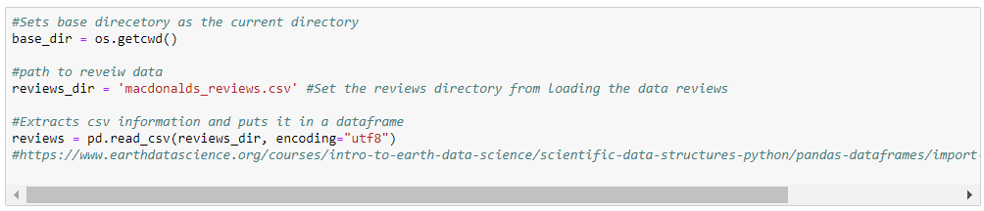
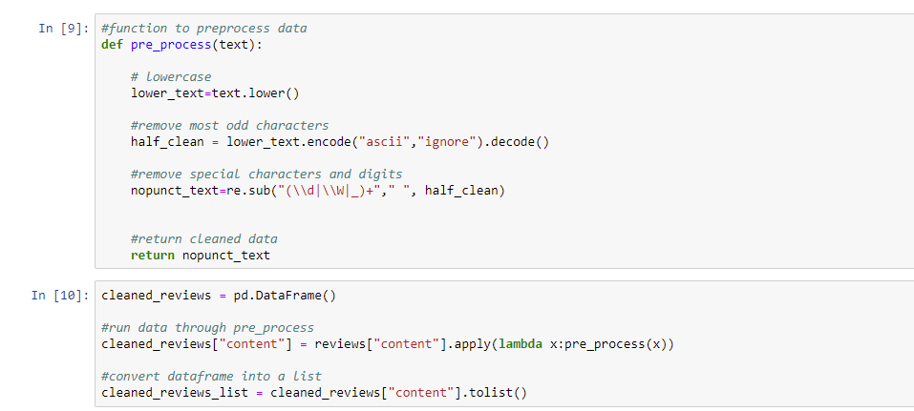
Data Processing
Data Loading
MacDonald, Deliveroo, Amazon, Disney Plus and Instagram
MacDonald was most preferred
Reviews neither too long or short
Relatively equal amount of reviews for each score
Extracted Reviews to csv file
Load the reviews into python
Data Cleaning
Lowercase data
Ignore characters that could not be encoded into ASCII
Remove punctuations and digits

Slide 6
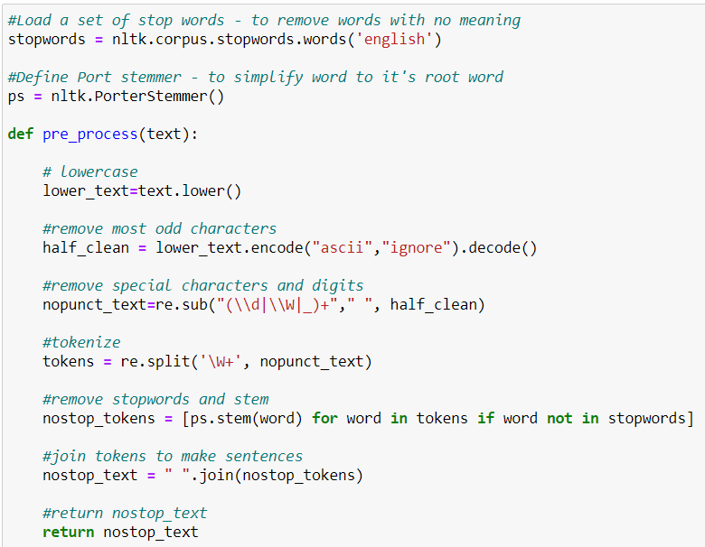
Data Processing
Data Cleaning (Alternative)
Lowercase data
Ignore characters that could not be encoded into ASCII
Remove punctuations and digits
Remove stopwords
Stem words
Produced a lower validation accuracy

Slide 7
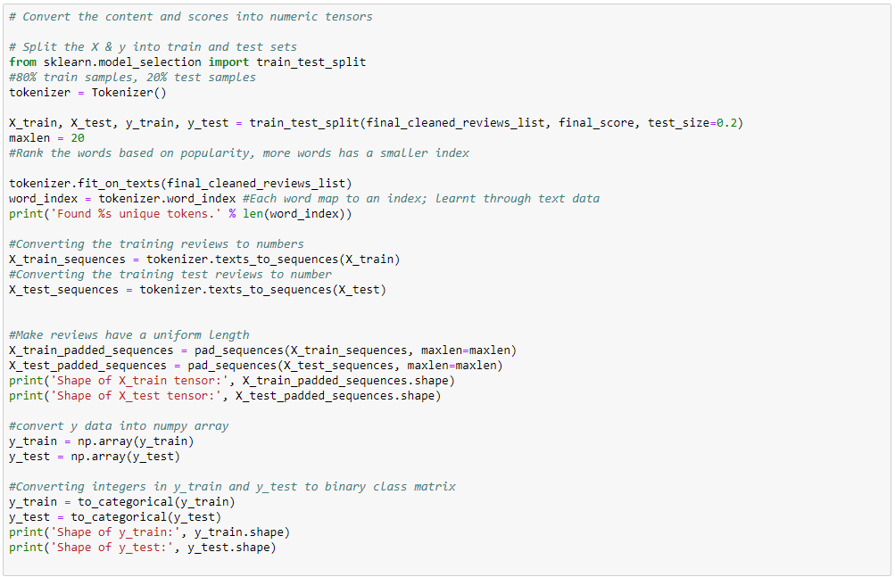
Data Processing
Data formatting and splitting
Tokenize the whole dataset for reviews
Converts training reviews to sequences
Added padding to the sequences to make the reviews have equal length
Converted scores into numpy arrays, then into binary class matrixes

Slide 8
PART 1 (GROUP)
03
NEO REI SIANG EDWARD
Notes:
Edward - Now I will be going the model i built

Slide 9
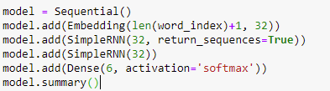
Baseline Model
1 Embedding Layer
2 SimpleRNN Layers
1 Dense Layer
Input: Number of Unique Characters
Output: 32 Dimensions
32 Nodes
6 Nodes
Reason: 6 score values (0,1,2,3,4,5)
Notes:
Edward - For the baseline model, the model is built using one embedding layer, with the input being the number of unique words and 32 as the vocab’s output dimensions. 2 SimpleRNN layers were also used at 32 Nodes. Lastly, one dense layer with 6 nodes is also used. 6 nodes is used because there are 6 possible scores, 0,1,2,3,4,5.

Slide 10
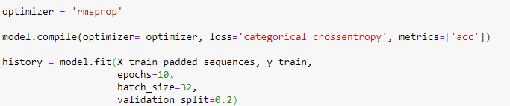
Baseline Model
Compiling
Fitting
Optimiser = “rmsprop”
Loss = “categorical_crossentropy” - Multiple classes
Metric = “acc” - Accuracy of classifying text into appropriate label
Epochs = 10
Batch Size = 32
Validation Split = 0.2 - Splits 20% of Training Data as Validation
Notes:
Edward- For compiling and fitting the model, rmsprop optimiser at default learning rate is used. Loss is set to categorical_crossentropy as there are multiple classes. Metrics is set to acc as we are trying to find out the accuracy of classifying strings into their appropriate label. The epochs were set to 10, batch size to 32 and validation split at 0.2

Slide 11
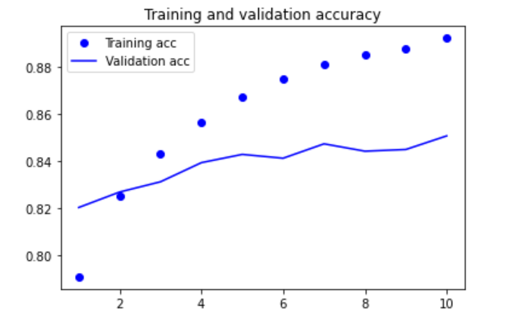
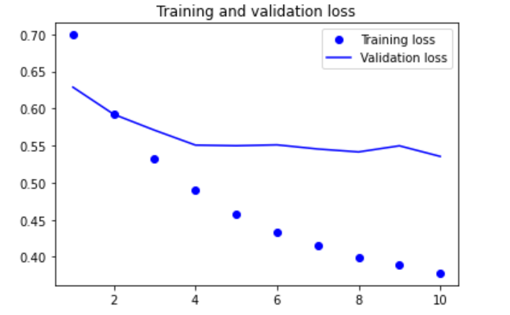
BaseLine Model
Accuracy Graph
Loss Graph
Notes:
Edward- So this his how the baseline model looks like

Slide 12
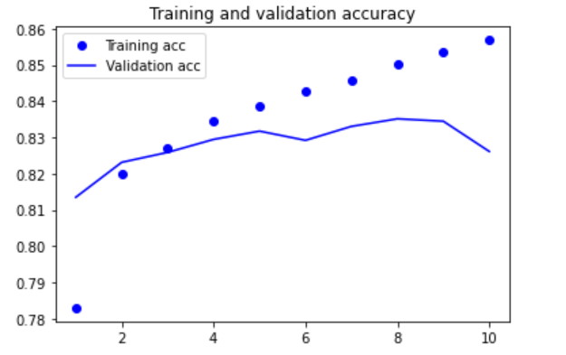
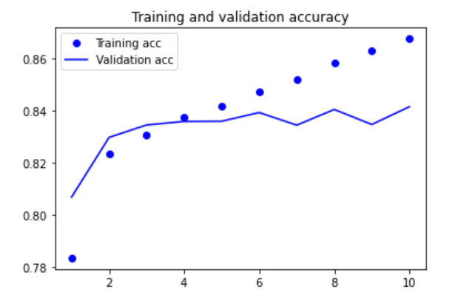
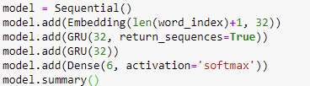
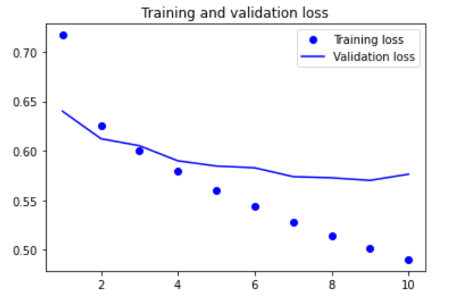
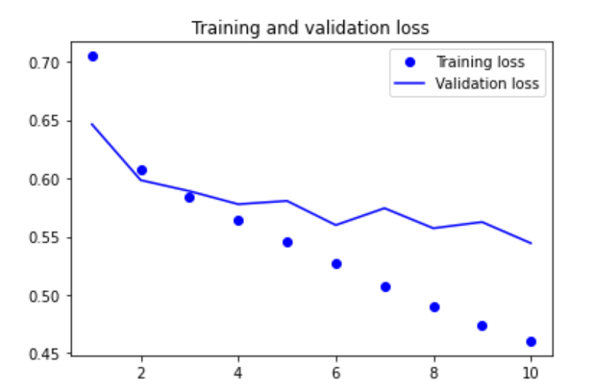
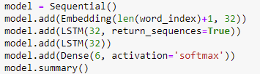
Model Better Than BaseLine
Used GRU Layers
<--------------------------
Used LSTM Layers
-------------------------->
Result:
SimpleRNN layers were still used
Explanation:
Lower validation accuracy
Overfit not fit
Notes:
To make a model better than the baseline, I first tried to change the layers and experimented with GRU and LSTM. But, SimpleRNN layers were better.

Slide 13
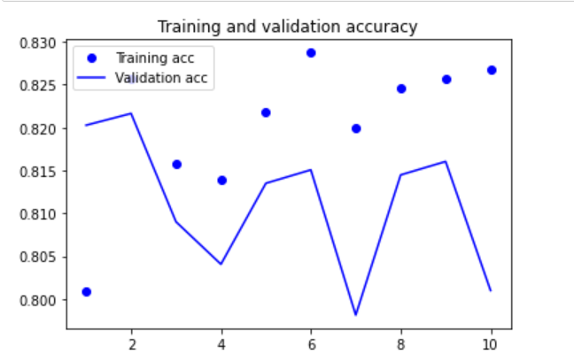
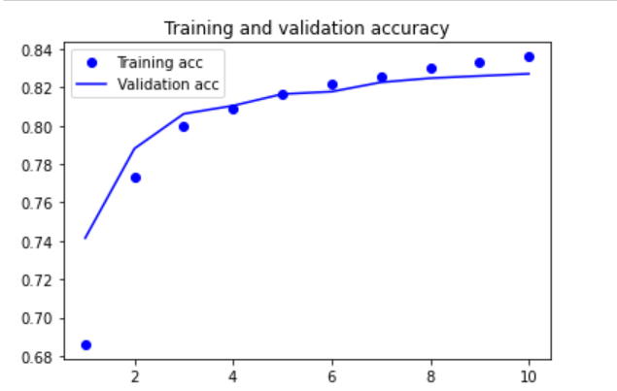
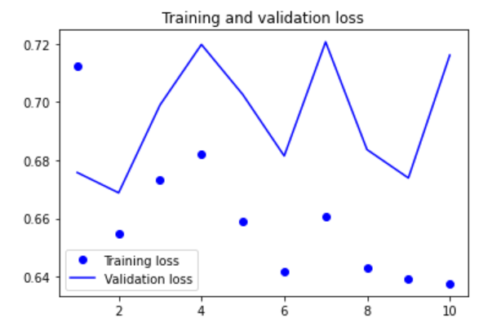
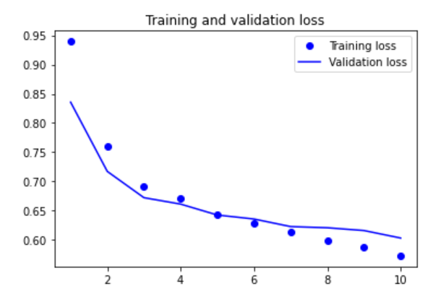
Model Better Than BaseLine
Used Adam LR @ 0.01
<--------------------------------
Used SGD LR @ 0.01
------------------------------>
Result:
SGD Learning Rate @ 0.01 Used
Explanation:
Adam Performed poorly
Overfit fixed with SGD LR
Notes:
Edward - Next, Adam and SGD optimizers would tested as well to see if the model would perform better. SGD optimiser performed better and thus was used

Slide 14
Model Better Than BaseLine
Accuracy Graph
Loss Graph
Notes:
Edward- This is how the model that is better than the baseline look.

Slide 15
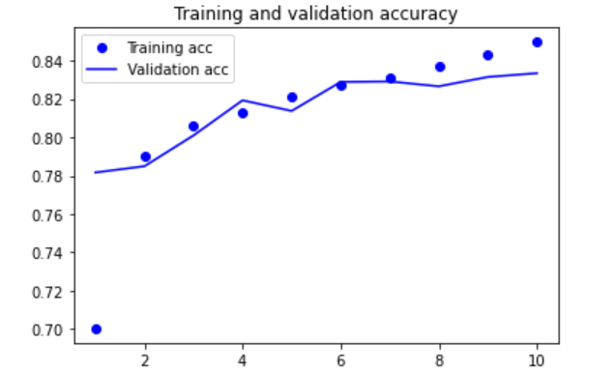
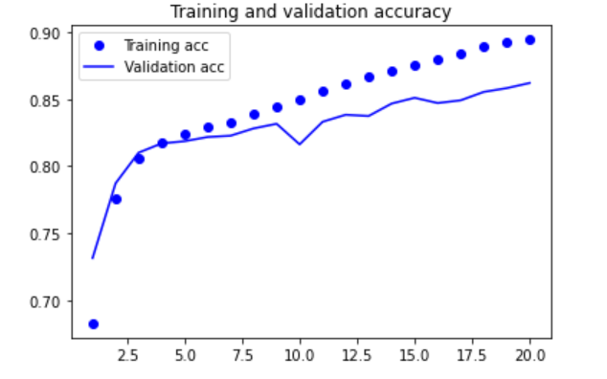
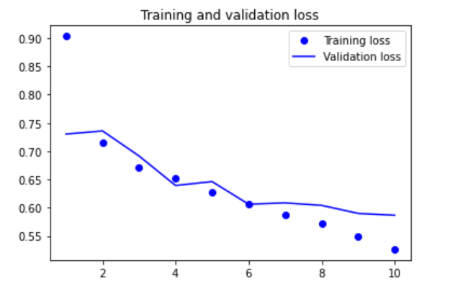
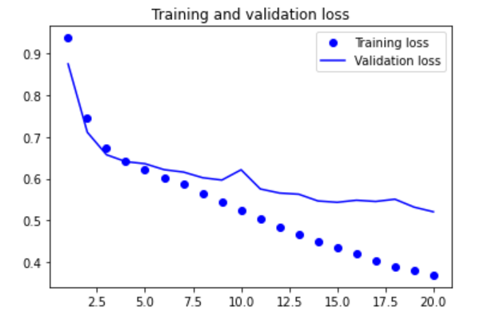
Scaling Up The Model
4 Layers @ 64 Nodes
<------------------------------
Increasing To 20 Epochs
----------------------------------->
Notes:
Next is scaling up the model, 4 SimpleRNN layers @ 64 nodes were used and the epochs increased to 20

Slide 16
Scaled Up Model
Accuracy Graph
Loss Graph
Notes:
Edward- This is how the scaled up model looks like

Slide 17
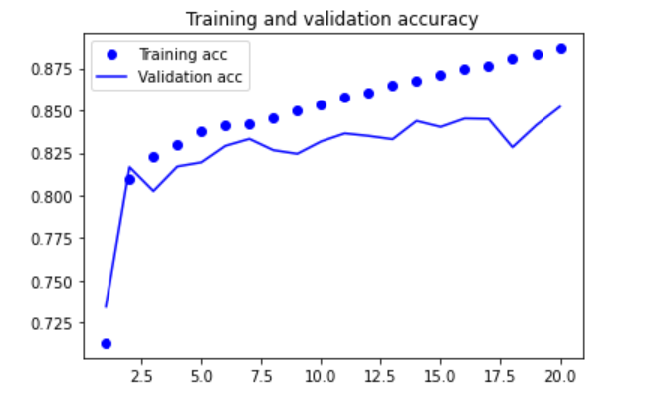
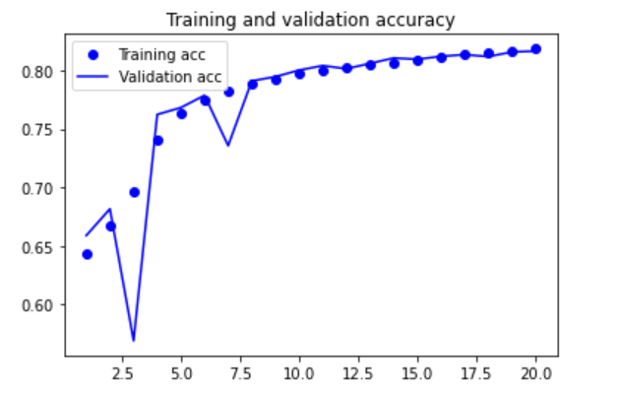
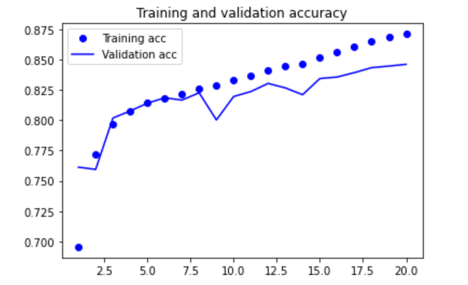
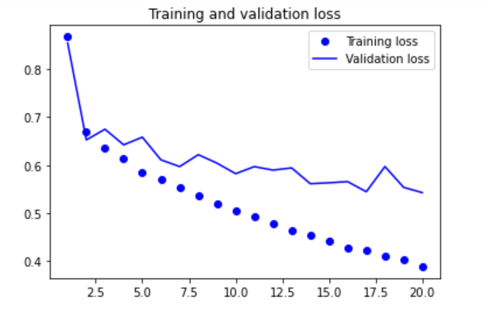
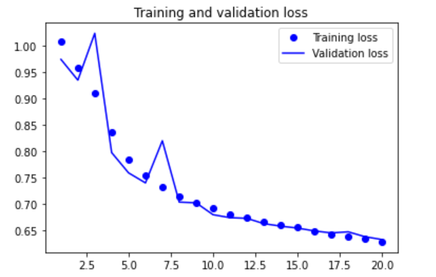
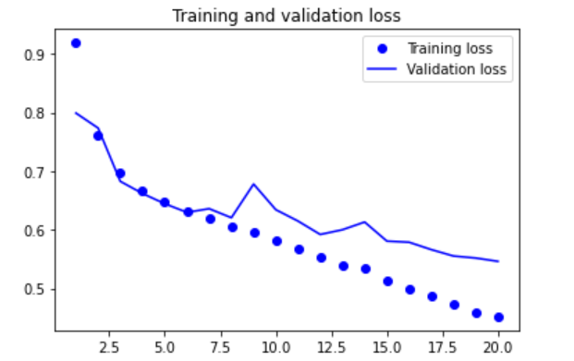
Adjusting Hyperparameters
Learning Rate @ 0.05
Learning Rate @ 0.001
Result:
SGD Learning Rate @ 0.01 Used
Learning Rate @ 0.005
Explanation:
0.05 Performed Worse
& 0.005 Had Not Much Effect & Took Longer
0.001 Was More Inconsistent & Had A Lower Value
Notes:
Edward- Next is adjusting hyperparameters, learning rate was adjusted first. However, default learning rate was still used as the a faster and slower learning rate did not help improve the model.

Slide 18
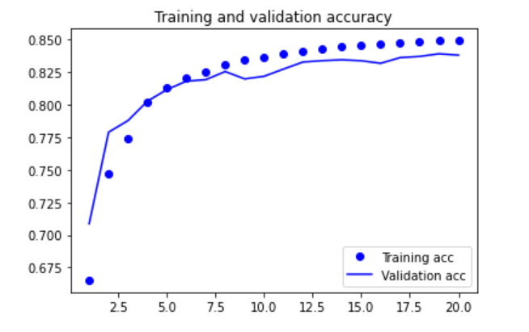
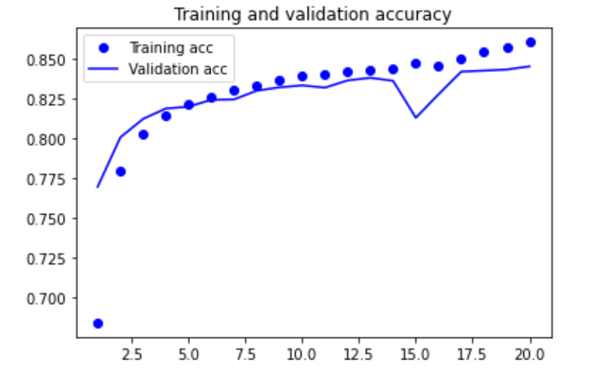
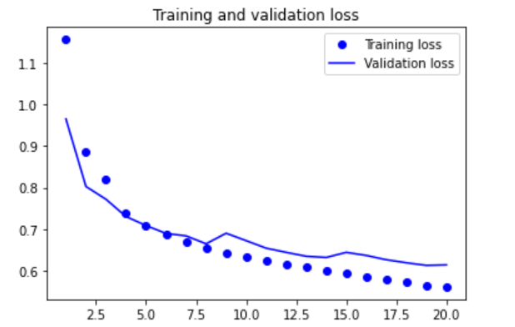
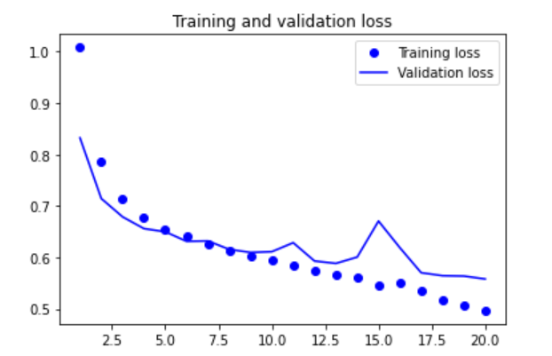
Adjusting Hyperparameters
Kernel Regularizer @ 0.1
<------------------------------
Kernel Regularizer @0.01
----------------------------------->
Result: Kernel Regularizer @ 0.1 Used
Explanation:
Higher Training Accuracy In General
Validation Accuracy More Consistent
Notes:
Edward - Kernel Regularizers were tuned next, values of 0.1 and 0.01 were used. 0.1 was used in the end as validation accuracy was more consistent.

Slide 19
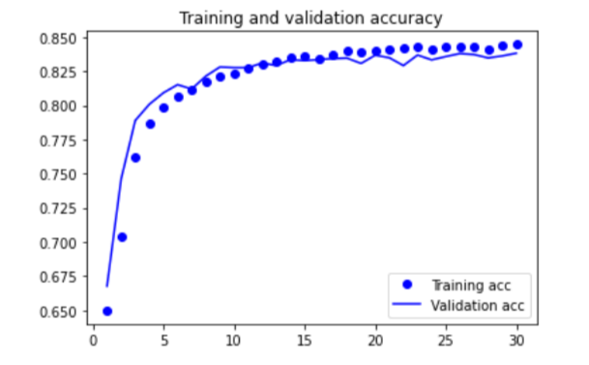
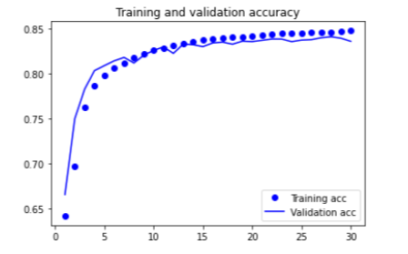
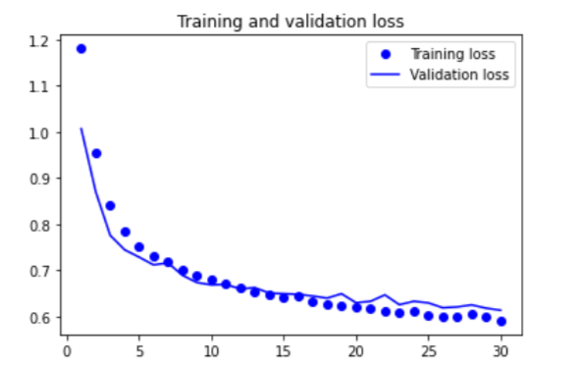
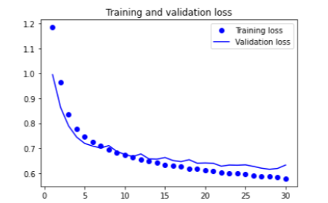
Adjusting Hyperparameters
Embedding Layer @ 16 Dimensions
<------------------------------
Embedding Layer @ 64 Dimensions
----------------------------------->
Result:
Embedding Layer @ 32 Was Decided To Be Used
Explanation:
Validation Accuracy Was Slightly Higher
Slightly Overfit Less
Notes:
Edward - Next embedding layer output dimensions is adjusted. Default value of 32 was used as the validation accuracy was slightly higher and slightly overfit less.

Slide 20
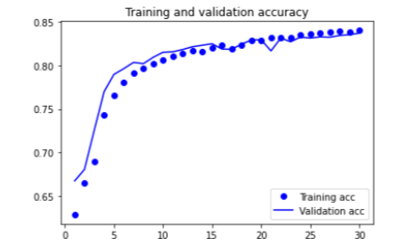
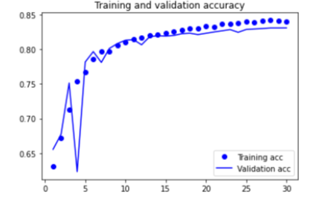
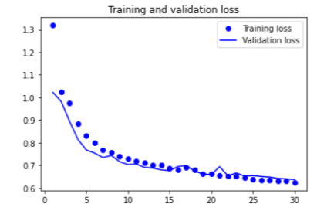
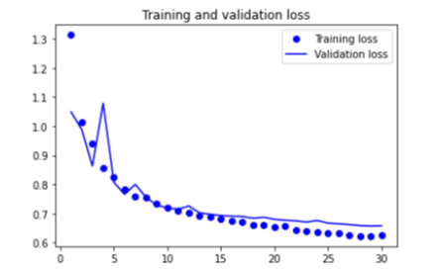
Adjusting Hyperparameters
Batch Size @ 16
<-----------------------
Batch Size @ 64
----------------------->
Result:
Batch Size @ 32 Was Decided To Be Used
Explanation:
Validation Accuracy Was Higher & More Consistent
Notes:
Edward - Next, different batch size was tested, but 32 was still use as the validation accuracy was higher and more consistent

Slide 21
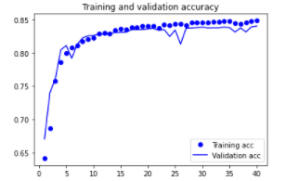
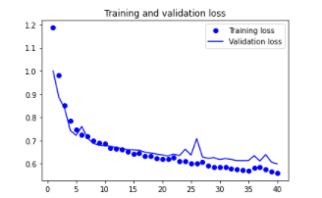
Final Model
Accuracy Graph
Loss Graph
Increased Epochs To 40
Added 4 Layers of Dropout @ 0.1
Added 4 Recurrent Dropout @ 0.1
Notes:
Edward - Lastly, I increased the epochs to 40 to ensure the validation accuracy is limiting and 4 layers of dropout and recurrent dropout were used at 0.1.

Slide 22
PART 1 (GROUP)
04
Low Tze Han Dexter

Slide 23
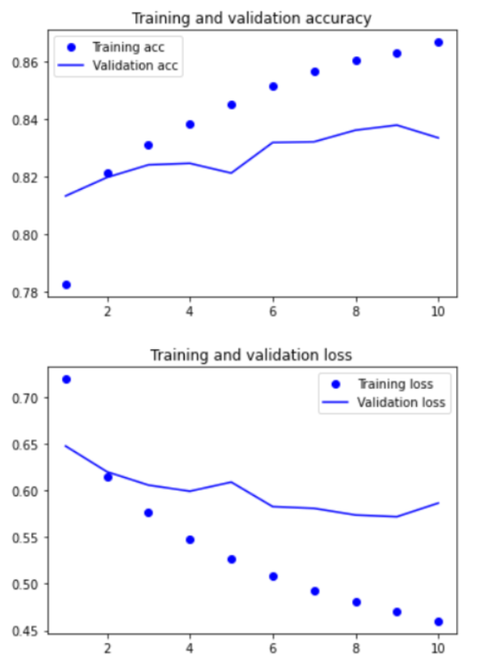
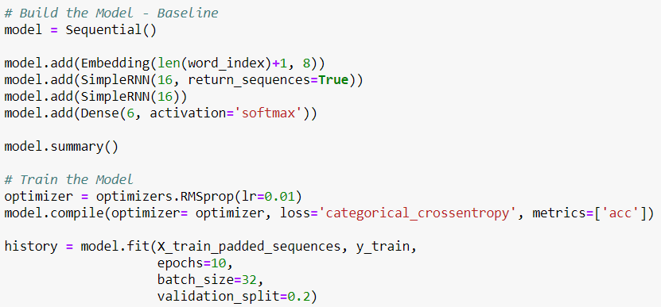
Baseline model
Baseline
1 Embedding layer of 8 neurons
2 SimpleRNN layers of 16 neurons
RMSprop optimizer (default learning rate)
Batchsize 32
10 epochs
Best val acc = 0.83

Slide 24
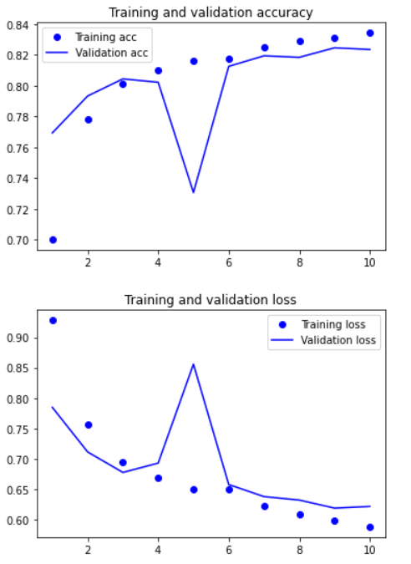
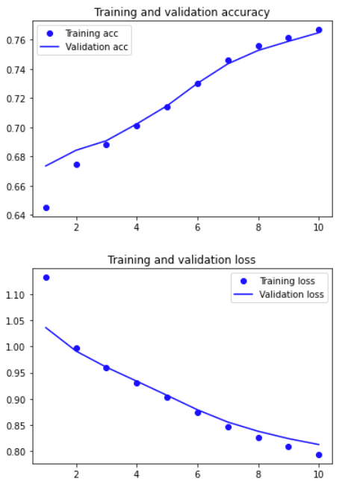
Find best optimizer
RMSprop (lr = 0.01) - Base
SGD (lr = 0.01) - Best
Adagrad (lr = 0.01) - Worst
Best val acc = 0.83
Best val acc = 0.82
Best val acc = 0.76
Fast overfit
Decent Acc & overfit
Worst Acc

Slide 25
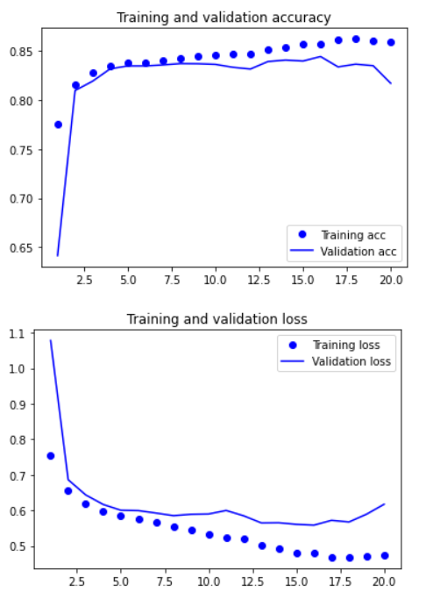
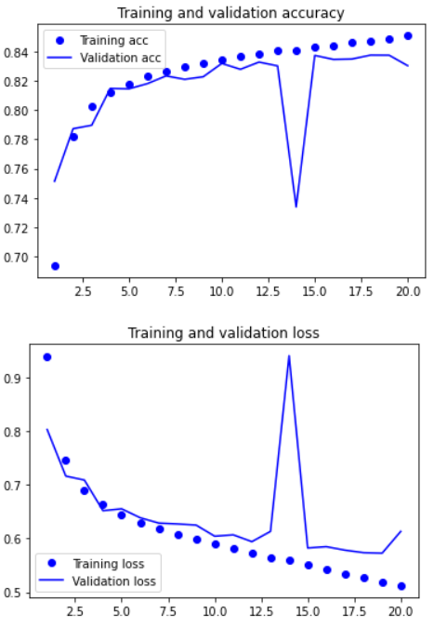
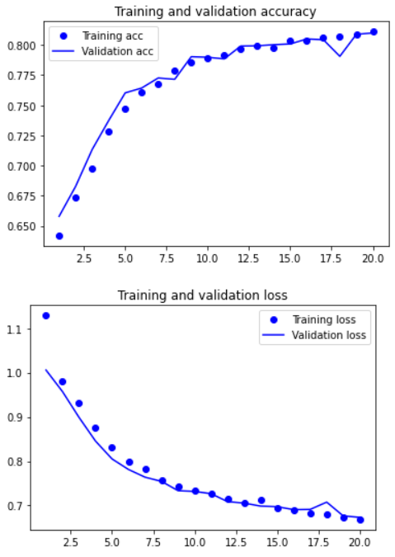
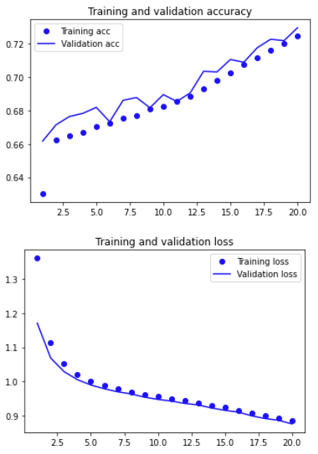
Find best learning rate
SGD (lr = 0.0001) - Boundary
SGD (lr = 0.1) - Worse
SGD (lr = 0.01) - Base
SGD (lr = 0.001) - Best
Worse overfit
Slight overfit
No overfit
Worse val acc

Slide 26


Find best layer type
SimpleRNN - Base/Best
GRU
LSTM
Best val acc = 0.83
Best val acc = 0.70
Best val acc = 0.66
Decent val acc
Very low val acc
Very low val acc
Notes:
Decent validation accuracy compared to the rest

Slide 27




Scaling up model
(Increase to 50 epoch)
Base x2 neurons and
embedding layers
Combined both improvements
+2 layers and x4 neurons
- Best
Base +2 layers
Best val acc = 0.82
Best val acc = 0.81
Best val acc = 0.84
Best val acc = 0.87
Deproved val acc
Deproved val acc
Slightly improved val acc
Greatly improved val acc
Notes:
To improve the model, i tested on what improves the model and ended up with a 0.87 val acc by adding 2 layers and quadrupling the neurons.

Slide 28



Fix overfit - L2 regularizer
L2 = 0.05
L2 = 0.01 (default) - Best
L2 = 0.001
Best val acc = 0.78
Best val acc = 0.81
Best val acc = 0.85
Fixed overfit but
Greatly reduced val acc
Reduced overfit but Deproved val acc
Overfit remains with slightly deproved val acc

Slide 29



Fix overfit - L1 regularizer
L1 = 0.01 (default)
L1 = 0.001 - Best
L1 = 0.001
Best val acc = 0.67
Best val acc = 0.81
Best val acc = 0.85
Reduced overfit but Deproved val acc
Overfit remains with slightly deproved val acc
Greatly reduced val acc

Slide 30



Fix overfit - dropout
Dropout = 0.2 - Best
Dropout = 0.3
Dropout = 0.4
Best val acc = 0.82
Best val acc = 0.81
Best val acc = 0.80
Fixed overfit but
Reduced val acc
Fixed overfit but
Greatly reduced val acc
Fixed overfit with
Greatly reduced val acc

Slide 31


Fix overfit - recurrent dropout
recurrent_dropout = 0.2 - Best
recurrent_dropout = 0.3
Best val acc = 0.81
Best val acc = 0.72
Fixed overfit but
Greatly reduced val acc
Fixed overfit but
Greatly reduced val acc

Slide 32




Comparing regularizers
L2 = 0.01
L1 = 0.001
Dropout = 0.2 - Best
recurrent_dropout = 0.2
Best val acc = 0.82
Best val acc = 0.81
Best val acc = 0.84
Best val acc = 0.81
Slight overfit
Decent overfit
No overfit with best val acc
No overfit
Notes:
The reason tried all many types of regulerizers is because i had trouble balancing fixing the over fit and having a high val acc. By comparing the best of each regularizer, i found the best to balance this was to use 0.2 dropout.

Slide 33


Compare with and without regularizer
No regularizing - Base/Best
Dropout = 0.2
Best val acc = 0.88
Best val acc = 0.85

Slide 34




Check best learning rate
Learning rate = 0.05
Learning rate = 0.01 - Best
Learning rate = 0.001 - Base
Learning rate = 0.0008
Best val acc = 0.86
Best val acc = 0.89
Best val acc = 0.85
Best val acc = 0.84

Slide 35



Batch size
Batch size = 64
Batch size = 32 - Base
Batch size = 16
Batch size = 8 - Best
Best val acc = 0.8900
Best val acc = 0.8963
Best val acc = 0.9046
Best val acc = 0.9097

Slide 36

Run longer epochs
Epoch = 40
Epoch = 60 - Final
Best val acc = 0.9097
Best val acc = 0.9106

Slide 37

Final model
Baseline val acc = 0.83
+7%
Baseline
1 Embedding layer of 128 neurons
4 SimpleRNN layers of 256 neurons
SGD optimizer (default learning rate)
Batchsize 8
60 epochs
Final val acc = 0.9106

Slide 38
PART 1 (GROUP)
05
Isha Kamal Jethmal

Slide 39

Baseline Model
One LSTM layer, 64 nodes
One dropout layer
One dense layer, 32 nodes, activation ‘relu’
Final dense layer, 6 nodes, activation ‘softmax’

Slide 40

Baseline Model
Accuracy Graph

Slide 41

Scaled up Model
Added new LSTM Layer, 64 nodes
Moved Dropout layer

Slide 42

Scaled up Model
Optimizer: SGD (Stochastic Gradient Descent)
- also tried RMSprop, but this optimizer yielded higher validation accuracy.
Learning rate decreased to 0.01, as it helped accuracy increase in a stable manner.

Slide 43


Scaled up Model
Accuracy Graph
Loss Graph
Scaled up model begins to overfit around 9th epoch, so no. of epochs reduced from 20 to 15.

Slide 44

Reduced Network Size
Removed one LSTM layer.
Moved dropout layer.
Optimizer and learning rate unchanged.

Slide 45


Reduced Network Size
Accuracy Graph
Loss Graph
To reduce overfitting, model was reduced in complexity. This helped it achieve a slightly higher accuracy

Slide 46

Added Regularization
Added L2 weight regularization on Dense layer. Value of 0.001 worked well in preventing overfitting.

Slide 47


Added Regularization
Accuracy Graph
Loss Graph
To further reduce overfitting, added regularization. This helped to make the validation accuracy performance curve smoother, which helped produce a better test accuracy.

Slide 48
Comparison
Final
Baseline
The model was scaled up from the baseline until it reached its peak performance. The final model’s validation accuracy is more similar to the training accuracy than the baseline model’s, which made the test score more consistent with the model’s performance.

Slide 49
PART 1 (GROUP)
06
Yeo Hiong Kai

Slide 50


BaseLine Model
2 SimpleRNN layers with 32 units in each layer
RMSProp learning rate of 0.001
Batch size used 32

Slide 51

BaseLine Model
Accuracy Graph
Loss Graph

Slide 52


Changed number of units in SimpleRNN layer
Increased the number of units in each SimpleRNN layer to 64 instead of 32
To overfit the model

Slide 53


Add another SimpleRNN layer
Added another Simple RNN layer on top of the existing layers
To improve model accuracy and overfit the model

Slide 54


Changed number of epochs
Changed the number of epochs executed to 30
To see whether the model overfits

Slide 55


Changed batch size
Changed the batch size to 128
To improve model performance

Slide 56


Changed number of epochs
Changed the number of epochs executed to 50
To see whether the model overfits

Slide 57


Final batch size
Changed the batch size to 256
To improve model accuracy

Slide 58


Changed number of units in SimpleRNN layer
Changed the number of units in each SimpleRNN layer to 128
To achieve better model results

Slide 59


Add dropout layers
Added two dropout layers with dropout rate of 0.3 in each layer
To improve validation accuracy

Slide 60


Change dropout rates
Changed the dropout rates in both dropout layers to 0.4
To reduce overfitting

Slide 61
Final Model
3 SimpleRNN layers with 128 units in each layer
2 dropout layers in between each SimpleRNN layer with dropout rate of 0.3
RMSProp learning rate at default value of 0.001
Batch size 256
50 epochs

Slide 62
Final Model
Accuracy Graph
Loss Graph

Slide 63
PART 1 (GROUP)
07
Ben Aw Yong Keen Weng

Slide 64



Baseline Model
One LSTM layer with 64 units
Optimiser: RMSprop(1e-4)
Batch size: 8

Slide 65


Baseline Model
Accuracy Graph
Loss Graph
Baseline Validation Accuracy: 0.829

Slide 66


Adding layers
Two LSTM layers with 64 units
Validation accuracy: 0.829

Slide 67


Adding layers
Three LSTM layers with 64 units
Validation accuracy: 0.829

Slide 68


Change LSTM Units
Two LSTM layers with 128 units
Validation accuracy: 0.8295

Slide 69


Changing optimiser
RMSprop
Validation Acc: 0.8295
SGD
Validation Acc: 0.6607
Adam
Validation Acc: 0.8753

Slide 70

Changing Learning Rate
Adam (lr=1e-4)
Validation Acc: 0.8753
Adam (lr=1e-3)
Validation Acc: 0.9012

Slide 71

Changing batch size
Batch Size: 8
Validation Acc: 0.9012
Batch Size: 32
Validation Acc: 0.9092

Slide 72

Adding Dropout
Add Dropout to fix overfitting
Added Recurrent Dropout of 0.2 on all LSTM layers
Added Dropout layers of 0.2

Slide 73

Final Model
Two LSTM layers with 128 units
Recurrent Dropout of 0.2
Dropout layers of 0.2
Optimiser: Adam with lr of 1e-3
Batch Size: 32
Final Validation Accuracy: 0.9084
Test Accuracy: 0.9057

Slide 74
PART 1 (GROUP)
08
Testing

Slide 75






Testing Of Everyone’s Models

Slide 76





Testing Of Best Model

Slide 77
PART 1 (GROUP)
09
Conclusion

Slide 78
Member | Conclusion
Edward | Quite satisfied with a 0.845 test accuracy but could be further improved. Could have removed words with extremely low frequency for Group’s data cleaning Could have removed duplicates for Group’s data cleaning Could have tried out other layers such as conv1D, Maxpool1D, BiGRU, or BiLSTM layers Could have tested out other optimizers such as Adadelta, Adagrad, Adamax
Dexter | Satisfied with the 7% improvement and a final testing accuracy of 0.925 Could have started with stronger baseline model Could have tried testing layer type first before optimizers Could have removed words with extremely low frequency for Group’s data cleaning Could have removed duplicates for Group’s data cleaning
Isha | 0.837 accuracy left a lot of room for improvement could have experimented more with different types of layers
Hiong Kai | Could have experimented with weight regularizers to reduce overfitting Could have used learning rate to improve model accuracy Could have tried using other layers including LSTM, GRU Could have changed the units in each layer to prevent overfitting
Ben | Content with 0.9057 testing accuracy Could have used other layers such as SimpleRNN, GRU, Conv1D, MaxPooling1D Could have experimented with adding more LSTM layers Could have added more dropout to further combat overfitting

Slide 79
PART 2
Individual

Slide 80
Overview
Problem Of The Assignment
implement a recurrent neural network to create an english language character generator that is capable of building semi-coherent english sentences
Approach Of The Assignment
Objective Of The Assignment
load and clean data
Build and train model
Generate words with model
Follow Universal Machine Learning Workflow
Build and train a model to generate text automatically, character-by-character
Notes:
Problem of the Assignment is to implement a recurrent neural network to create an english language character generator that is capable of building semi-coherent english sentences
Objective of the Assignment is to Build and train a model to generate text automatically, character-by-character
Approach of the assignment is to load and clean the data, build and train model, generate words with model, and follow universal machine learning workflow.

Slide 81
PART 2 (Individual)
01
Neo Rei Siang Edward
Notes:
Now I will be talking about the model for the individual portion

Slide 82



Data
Data Encoding
Cleaned data is one hot encoded into binary class matrix.
03
Data Loading
Text data is downloaded from mel.
File is opened and contents is saved into a variable.
01
02
Data cleaning
All text data is converted into lower capitals.
Unnecessary characters are removed.
Notes:
First is data loading, data cleaning, and data encoding. Text data is downloaded and saved into a variable. The text data then undergoes cleaning by making all characters lowercase and unnecessary characters are removed. The cleaned text data is then one hot encoded into binary arrays.

Slide 83



Baseline Model
1 LSTM Layer
1 Dense Layer
128 Nodes
Input: Number of Characters In A Sequence & Number of Unique Characters
Node Value = Number of Unique Characters
Output probability prediction for each unique characters
Notes:
For the building of the baseline model, I used 1 LSTM layer at 128 nodes, with the input being the number of characters in a sequence, which is 60, and the number of unique characters in the text data, which is 39. Then, one dense layer is used. The nodes for the dense layer is also 39 since the model is outputting probability prediction for each unique character.

Slide 84
Baseline Model
Compiling
Fitting
Optimiser = “rmsprop”
Loss = “categorical_crossentropy” - Multiple classes
Metric = “acc” - Accuracy of probability prediction
Epochs = 10
Batch Size = 128
Validation Split = 0.2 - Splits 20% of Training Data as Validation
Notes:
For the compiling and fitting of the model, the optimiser used was rmsprop and the default learning rate was used. The loss was set to categorical_crossentropy as there are multiple classes involved. The metrics is set to acc as we are trying to find the model’s accuracy of probability prediction made by the model. The epochs was set to 10 and batch size to 128. The validation split is 0.2 as it takes 20 % of the training data to become validation data

Slide 85




BaseLine Model
Accuracy Graph
Loss Graph
There were mistakes in spelling and sentences made did not make much sense
Notes:
So this is how the baseline model looks like. The text generated made mistakes in spelling and the sentences formed did not make sense.

Slide 86




Model Better Than BaseLine
Used GRU Layers
<--------------------------
Used SimpleRNN Layers
----------------------------------->
Result:
LSTM Layers Used
Explanation:
Validation Accuracy Was Higher
Notes:
To create a model better than a baseline, a few things were tested. Firstly, GRU and SimpleRNN layers were tested out to see if it would make the model better. Unfortunately, it did not.

Slide 87




Model Better Than BaseLine
Used Adam LR @ 0.01
<--------------------------------
Used SGD LR @ 0.01
----------------------------->
Result:
Undecided
Explanation:
SGD Learning Rate Performed Poorly
Adam Learning Rate Performed Similarly
Notes:
Next, Adam and SGD optimizers were tested out instead to see if the model can improve. The SGD learning rate performed poorly, but the adam learning rate performed similarly. Thus, i experimented further with the two optimizers.

Slide 88



Model Better Than BaseLine
Used Adam LR @ 0.001
<-----------------------------------
Used RMSprop LR @ 0.001
--------------------------------------->
Results:
Used RMSprop LR @ 0.001
Explanation:
Accuracy is higher within the same range of epochs
Notes:
Both Adam and RMSprop learning rate were tested at 0.001 learning rate. In the end, RMSprop was used as the accuracy is higher within the same range of epochs.

Slide 89



Model Better Than BaseLine
Accuracy Graph
Loss Graph
There were still spelling mistakes being made by the model
Notes:
So this is how the model better than baseline looks like. The text generated however still had mistakes and more improvements had to be done.

Slide 90


Scaling Up The Model
Epochs Not Increased As Signs Of Overfitting Is Already Being Shown
3 Layers @ 256 Nodes
<--------------------------------
Notes:
Next. the model is scaled up. 3 LSTM layers with 256 nodes were used. Epochs were not increased because the graph showed signs of overfitting from the fourth epoch.

Slide 91


Scaled Up Model
Accuracy Graph
Loss Graph
Model was still make mistakes in spelling for some words
Notes:
Thus, this is a close look on the scaled model. The words generated however is still not up to par as the model still made mistakes in spelling for some words

Slide 92




Adjusting Hyperparameters
LR @ 0.05
<-------------
LR @ 0.0005
------------------>
Result:
LR @ 0.001 Was Still Used
Explanation:
LR@0.05 validation accuracy already showed signs of limitations
LR@ 0.0005 is inefficient
Notes:
For adjusting of hyperparameters, learning rate was adjusted first. 0.5 and 0.0005 were used. However, 0.001 learning rate was still used because 0.05 showed signs of validation accuracy limiting alrd, and 0.0005 is inefficient as it took a long time.

Slide 93




Adjusting Hyperparameters
Kernel Regularizer @ 0.01
<------------------------------------
Kernel Regularizer @0.001
----------------------------------->
Result:
Kernel Regularizer @ 0.001 Was Decided To Be Used
Explanation:
0.001 offered more room for improvement of the model as there is a higher training accuracy
Notes:
Next, kernel regularizer values were tested next. 0.01 and 0.001 were used. 0.001 was decided to be used because it offered more room for improvement as there is a higher training accuracy.

Slide 94




Adjusting Hyperparameters
Batch Size @ 64
<----------------------
Batch Size @ 256
------------------------->
Result:
Batch Size @ 128 Was Still Decided To Be Used
Explanation:
Slightly less overfit with batch size @ 128
Notes:
Batch size was adjusted next to see if a higher or lower batch size will improve the model. Default batch size of 128 was still used because it was noticed that there was a slightly less overfit with a batch size of 128.

Slide 95



Adjusting Maxlen & Step
Accuracy Graph
Loss Graph
Maxlen = 100
Step = 2
Model performed better than the others. Only 3-4 spelling mistakes
Notes:
Next, i adjust maxlen and step values and tried out many combinations. The best combination was with maxlen at 100 and step at 2. The model had a higher validation accuracy and for the words generated, only 3-4 spelling mistakes were made.

Slide 96


Final Model
Accuracy Graph
Loss Graph
Increased Epochs To 50
Added 3 Layers of Dropout @ 0.3
Added 3 Recurrent Dropout @ 0.2
Notes:
I then increased the epochs to 50 to show the model is limiting. 3 layers of dropout at 0.3 and 3 recurrent dropouts at 0.2 were used as well.

Slide 97
Training Accuracy Development
0.60
0.55
0.70
0.59
Baseline Model
(Overfitted)
Model Better Than Baseline
(Slightly Overfitted)
Scaled Up Model
(Overfit)
Final Model
(No Overfit)
Validation Accuracy Development
0.55
0.53
0.55
0.59
Baseline Model
(Overfitted)
Model Better Than Baseline
(Slightly Overfitted)
Scaled Up Model
(Overfit)
Final Model
(No Overfit)
Notes:
This diagram shows the development of the training accuracy and validation accuracy throughout the processes.

Slide 98






Temperature Testing
Best temperature value was 0.5
There is no spelling mistake
However, sentence flow did not make much sense 0.4 had repetitions of words like “street” and “little” while 0.6 had a spelling mistake, “decersed”
Notes:
After using a user input of 100 characters, i used all temperature values for the text generation, and the best temperature value was 0.5 as there is no spelling mistakes. However, the sentences generated did not make much sense. Its closed competitors include temperature 0.4 and 0.6 but 0.4 had repetitions of words like “street” and “little” while 0.6 had a spelling mistake, “decersed”

Slide 99
Conclusion
Model’s Performance
Further Improvements
The model did average with only a validation accuracy of 0.59
Best Phrase “the papers which i have a written face”
No spelling mistakes
Sentences formed did not make much sense
Could use other metrics such as precision
Could have tried out other layers such as conv1D, Maxpooling1D, BiGRU, or BiLSTM layers
Could have tested out other optimizers such as Adadelta, Adagrad, Adamax
Could try out other regularizers such as recurrent regularizers and embeddings regularizer
Notes:
In conclusion, the model did quite average as it only had a validation accuracy of 0.59. The words generated were not bad. I think the best phrase produced was, “the papers which i have a written face”. No spelling mistakes were made but overall the sentences formed did not make much sense. Some improvements that could be made includes trying other layers such as conv1D, maxpooling1D, biGru, or biLSTM. Other optimisers such as Adadelta, Adagrad, Adamax could have been tested. Other type of regularizers such as recurrent regularizers and embeddings regularizer could have been experimented with as well.

Slide 100
PART 2 (Individual)
02
Low Tze Han Dexter

Slide 101

Data Loading
Load and check data contents to find what needs to be cleaned

Slide 102

Data Preprocessing - Data Cleaning
Clean data by:
Lowercase data
Manually remove odd characters and numbers

Slide 103

Data Preprocessing - Data Extraction
From the cleaned text, extract sections of sentences and target character

Slide 104

Data Preprocessing - Data Extraction
Map characters to a dictionary and use it to help one hot encode the data to make the x_train and y_train dataset

Slide 105

Baseline Model
Baseline model
3 LSTM layer
64 neurons
Rmsprop optimizer
Batch size 128
10 epochs

Slide 106


Baseline model
Baseline model results
Val acc = 0.53
Text generation (best at temp 0.5):
Incoherent
Some fake words
Some repetition

Slide 107

Text generation
Generate 200 characters of text based on the random seed of text from the holmes.txt
Prints 4 different text generations based on 4 different temperatures

Slide 108



Find best layer - 10 epochs
LSTM - Base/Best
SimpleRNN
GRU
Works properly
Dosen’t work
Dosen’t work

Slide 109



Find Best optimizer - 10 epochs
RMSprop - Base/Best
Adam
Nadam
Decent val acc/ incoherent/ little fake words
Low val acc/
incoherent/fake words
Low val acc/
incoherent/fake words

Slide 110




Find best parameters for optimizer - 20 epochs
RMSprop (lr = 0.1)
RMSprop (lr = 0.01)
- Base
RMSprop (lr = 0.001)
- Best
RMSprop (lr = 0.005)
Dosen’t work
Overfits quickly
Slightly overfits
Overfits quickly

Slide 111
Change temperature
Current temperatures
0.2 - too repetitive
0.5 - usually the best
1.0 - many fake words
1.2 - To many fake words
Changed temperatures
0.3 - boundary temperature
0.5 - mainly used
0.7 - mainly used
0.9 - boundary temperature

Slide 112




Scaling up - tweaking neurons - 30 epochs
Half neurons
64 neurons - Base/Best
Double neurons
Quadruple neurons
val acc= 0.48
val acc= 0.53
val acc= 0.51
val acc= 0.51
Greatly reduced val acc/
Totally incoherent
Decent val acc/
Somewhat coherent
Overfits quickly and deproves/
Incoherent with fake words
Overfits quickly and deproves/
Slightly incoherent

Slide 113


Scaling up - tweaking layers - 30 epochs
3 layers - Base/Best
Add 2 layers
Add 4 layers
Decent val acc
Greatly reduced val acc
Greatly reduced val acc

Slide 114
Observations
Model accuracy
Increasing neurons greatly improves the training accuracy but overfits quickly
Increasing layers only reduces training accuracy
Text generation
Best temperature to balance repetitiveness and real words is 0.5-0.7
Coherence of the text generation is generally based on the validation accuracy

Slide 115




Fixing overfit - L2 regularizer - 30 epochs
L2 = 0.01 - default
L2 = 0.001
L2 = 0.0005
L2 = 0.00001
val acc= 0.51
Dosen’t work
Dosen’t work
Dosen’t work
Only slightly reduces overfit and cannot be further increased

Slide 116


Fixing overfit - L1 regularizer - 30 epochs
L1 = 0.0001
L1 = 0.00001
val acc= 0.51
Dosen’t work
Only slightly reduces overfit and cannot be further increased

Slide 117


Fixing overfit - dropout - 30 epochs
dropout = 0.2
dropout = 0.3
val acc= 0.51
val acc= 0.50
Validation over training
Validation over training

Slide 118




Fixing overfit - Scale up dropout 0.2 - 60/80 epochs
dropout = 0.2 - Base
Double neurons
Quadruple neurons
Quadruple neurons at
80 epochs
val acc= 0.54
val acc= 0.57
val acc= 0.56
val acc= 0.56
Validation over training until end
Validation over training
Validation over training
Validation over training

Slide 119



Fixing overfit - recurrent dropout - 40 epochs
Recurrent dropout = 0.2 - Best
Recurrent dropout = 0.3
Recurrent dropout = 0.4
val acc= 0.55
val acc= 0.54
Fixes overfit/generates better text than 0,3
Fixes overfit
Breaks

Slide 120



Scaling up 2 - tweak neurons - 40 epochs
Quadruple neurons at 15 epochs
64 neurons - Base
Double neurons - Best
Quadruple neurons
val acc= 0.55
val acc= 0.57
val acc= 0.57
val acc= 0.58
Slightly coherent
Semi-coherent with real words
Slightly coherent with some fake words
Slightly incoherent with same fake words

Slide 121



Fix overfit 2 - Recurrent dropout - 40 epochs
Recurrent dropout = 0.2
- Base/Best
Recurrent dropout = 0.3
Recurrent dropout = 0.4
Recurrent dropout = 0.5
val acc= 0.57
val acc= 0.57
val acc= 0.57
val acc= 0.56
Semi-coherent with real words
Slightly coherent
Slightly coherent with some fake words
Slightly incoherent with same fake words

Slide 122


Fix overfit 2 - Recurrent regularizer - 40 epochs
No regularizer - Base/Best
Recurrent reg L2 = 0.3
Recurrent reg L2 = 0.3
val acc= 0.57
val acc= 0.53
val acc= 0.53
Semi-coherent with real words
Deproved val acc/Dosen’t fix overfit/ incoherent
Deproved val acc/Dosen’t fix overfit/ incoherent

Slide 123




Hyperparameters - batch size
Batch size = 32
Batch size = 64
Batch size = 128 - Base/Best
Batch size = 256
val acc= 0.57
val acc= 0.57
val acc= 0.57
val acc= 0.56
Incoherent
Slightly coherent
Semi-coherent with real words
Incoherent

Slide 124


Hyperparameters - maxlen
Maxlen = 30
Maxlen= 60 - Base
Maxlen = 90 - Best
val acc= 0.5791
val acc= 0.5788
val acc= 0.5823
Slightly coherent
Semi-coherent with real words
Slightly coherent

Slide 125


Hyperparameters - steps
Steps = 2 - Best
Steps = 3 - Base
Steps = 4
val acc= 0.5949
val acc= 0.5788
val acc= 0.5608
Slightly coherent
Semi-coherent with real words
Slightly coherent

Slide 126


Best model to generate text
Maxlen = 60
Steps = 3 - Base/Best
Maxlen = 90
Steps = 2
val acc = 0.5788
val acc= 0.5949
Semi-coherent
Some repetition
Little fake words
Slightly coherent
Many repetition
Many fake words

Slide 127

Final model
Best model
3 LSTM layer with 128 neurons
Rmsprop optimizer (lr=0.001)
Batch size 128
40 epochs
Maxlen = 60
Steps = 3
Temperature = 0.4
Text evaluation
Semi-coherent
Some repetition
Little fake words
val acc = 0.5788

Slide 128
Summary
Best generated text is produced around 0.57 validation accuracy
Quite satisfied with final model
Model performance (text evaluation) - can be further improved
Semi-coherent
Some repetition
Little fake words
Further improvements
Try different maxlen and steps combinations
Test text generation on user input rather than seed generation
Produce longer text to better evaluation model

Slide 129
PART 2 (Individual)
03
Isha Kamal Jethmal

Slide 130




Preparing the Data
2. Data Processing
1. Data Loading
3. Data Encoding

Slide 131


Baseline Model
Layers:
1 LSTM layer, 128 nodes
Final Dense layer, activation ‘softmax’
Optimizer (initial): RMSprop, learning rate = 0.02
Batch size: 128
Epochs: 10

Slide 132


Baseline Model
Accuracy
Loss

Slide 133

Baseline Model
repetition
All words found in dictionary
Less repetition
One non-english word
More non-english words

Slide 134


LSTM vs GRU
LSTM and GRU are types of Recurrent Neural Networks. Here, I tried both in the baseline model.
LSTM
GRU

Slide 135

Adam vs RMSprop
Adam and RMSprop are types of optimizers. Both were used, and the comparison is as shows.
(all other configurations kept the same)
Adam
RMSprop

Slide 136

Changing Maxlen
..
Maxlen = 30
Maxlen = 60

Slide 137
Scaled Up
Added another LSTM layer, 64 nodes.

Slide 138


Scaled Up
Model overfits around 5th epoch
Accuracy
Loss

Slide 139


Reduce Overfitting
Added dropout = 0.5
More epochs, decreased learning rate to 0.01

Slide 140

Final Model
Accuracy
Loss

Slide 141

Final Model
repetition
Less repetition
Most words found in dictionary
More non-english words
Temp 0.3 performed the best. 0.1 had too much repetition of words, and 0.5 had too many made-up words.

Slide 142
Baseline
Maxlen = 60

Slide 143
Final
Maxlen = 30

Slide 144
Conclusion
-Overall, satisfied with model improvement.
-Could have used other metrics to determine quality of generated text, because accuracy and loss are not as helpful in figuring out how the NLP model can be improved.
-Highest validation accuracy of ~53% leaves room for more improvement.
-The final model’s generated text with temperature 0.3 (the chosen best) still had two made-up words, so the quality of the text can be improved.

Slide 145
PART 2 (Individual)
04
Yeo Hiong Kai

Slide 146


Data Loading/Processing
Load data from holmes.txt
Split data into sentences and identify unique characters
Encode the data into arrays

Slide 147

BaseLine Model
1 LSTM layer with 128 units in each layer
RMSProp learning rate of 0.01
Batch size used 128

Slide 148

BaseLine Model
Accuracy Graph
Loss Graph

Slide 149


Changed batch size
Changed the batch size from 128 to 256
To improve the model accuracy

Slide 150


Added another LSTM layer
Added another LSTM layer with 128 units on top of the existing layer
To allow the model to overfit

Slide 151


Changed number of epochs
Changed the number of epochs executed to 40
To see whether the model overfits

Slide 152


Changed learning rate
Increased learning rate to 0.02
To increase model performance
Model overfits at the 23rd epoch

Slide 153


Added another LSTM layer
Revert learning rate back to 0.01
Added another LSTM layer with 128 units in the layer
To overfit model

Slide 154


Changed learning rate
Decreased learning rate to 0.005
Increase model performance

Slide 155


Changed learning rate
Decreased learning rate to 0.001
Increase model performance

Slide 156


Added dropout rates
Added two dropout layers with dropout rate of 0.4 in each layer
To improve validation accuracy

Slide 157


Change dropout rates
Changed the dropout rates in both dropout layers to 0.5
To reduce overfitting

Slide 158
Final Model
3 LSTM layers with 128 units in each layer
2 dropout layers in between each LSTM layer with dropout rate of 0.4
RMSProp learning rate set at 0.001
Batch size 256
40 epochs

Slide 159
Final Model
Accuracy Graph
Loss Graph

Slide 160


Chosen temperature
Text generated from temperature 0.2 and 0.4 are quite repetitive
Text generated from temperature 0.8, 1 and 1.2 contains words that does not exist
Chosen temperature is 0.6 as words generated are readable and are not repeated too much

Slide 161

Conclusion
Could have experimented with weight regularizers together with dropout layer
Could have tried to change number of layers and units in each layer to increase model performance
Could have tried to use different layers such as GRU and ConvLSTM2D
Text generated from user input

Slide 162
PART 2 (Individual)
05
Ben Aw Yong Keen Weng

Slide 163

Data Loading
Open holmes.txt file
Make text lowercase

Slide 164

Data Processing - Clean Data
Remove special characters and numbers
Replace \n with spaces

Slide 165


Data Processing - Text Sequence
Extract sequences from text
One-hot encode text sequence
Turn encoded text into 3D binary array

Slide 166


Baseline Model
One LSTM layer with 128 units
Validation Accuracy: 0.5548

Slide 167

Baseline Model - Generated Text
Temperature of 0.2 has a lot of repetition and minimal spelling mistakes
Temperatures of 1.0 and 1.2 have a lot of spelling mistakes and are not coherent

Slide 168

Change Layers
LSTM layer
Validation accuracy: 0.5548
GRU layer
Validation accuracy: 0.5105

Slide 169


Change Optimiser
RMSprop
Validation accuracy: 0.5548
SGD
Validation accuracy: 0.2367
Adam
Validation accuracy: 0.5556

Slide 170



Change Learning Rate
Adam (lr=0.001)
Val acc: 0.5037
Adam (lr=0.01)
Val acc: 0.5556
Adam (lr=0.02)
Val acc: 0.5471
Adam (lr=0.05)
Val acc: 0.5079

Slide 171


Scale Up the Model
1 LSTM layer
Validation accuracy: 0.5556
2 LSTM layer
Validation accuracy: 0.5618
3 LSTM layer
Validation accuracy: 0.5521

Slide 172


Change batch size
Batch Size: 64
Validation accuracy: 0.5460
Batch Size: 128
Validation accuracy: 0.5618
Batch Size: 256
Validation accuracy: 0.5591

Slide 173

Change maxlen
Maxlen: 30
Validation accuracy: 0.5325
Maxlen: 60
Validation accuracy: 0.5618

Slide 174

Current Model - Generated Text
Temperature of 0.2 has spelling mistakes and a lot of repetition
Temperature of 0.5 has minimal repetition and minimal spelling mistakes
High temperatures (1.0, 1.2) have a lot of non-english words and are not coherent

Slide 175

Add Dropout
Add two Dropout layers of 0.1 for each LSTM layer
Reduce overfitting

Slide 176

Final Model
Two LSTM layers of 128 units
Two Dropout layers of 0.1
Adam optimiser (lr = 0.01)
Batch Size: 128
Maxlen: 60
Validation Accuracy: 0.5706

Slide 177


Final Model - Generated Text Evaluation
Best Temperature: 0.4
No spelling mistakes
Minimal repetition
Low temperatures (0.1, 0.2) have a lot of repetition
High temperatures have a lot of spelling mistakes

Slide 178
Conclusion
Model Performance
Model achieved decent accuracy
Validation accuracy can be improved
Possible further improvements
Could have changed the number of units in the LSTM layers
Could have used regularisers to reduce overfitting

Slide 179
Thank You!

